Slide 1
Ticket System Microservice Project
Jeremiah Dy
Project duration: 1 month (May 2025)

Slide 2
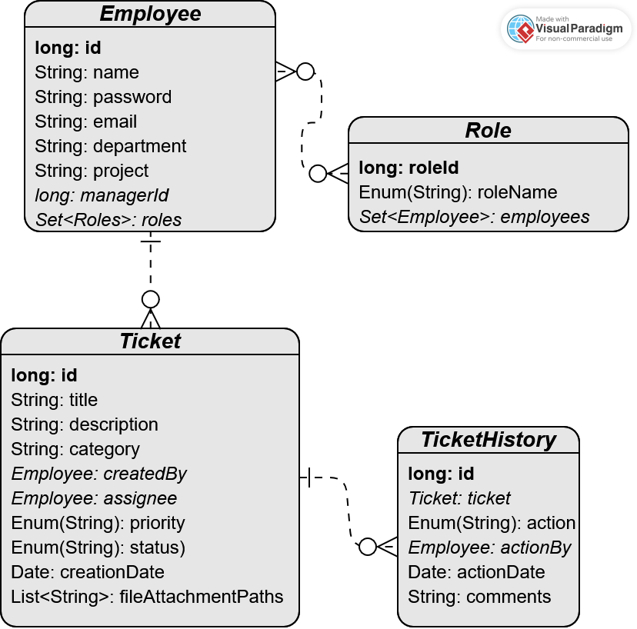
Ticket Entity Relationship Diagram

Slide 3
Project Architecture
ticketinggateway
ticketmicroservice
notificationmicroservice
Spring-boot
Maven
Spring-security
Spring Data JPA
MySQL Database
jQuery
Bootstrap CSS
~~~~~~~~~~~~~~~~~~~
This microservice serves the frontend of the project application.
It allows users to login/logout and create/modify tickets through HTTP requests to ticketmicroservice.
Spring-boot
Maven
Spring Data JPA
MySQL Database
ActiveMQ
Jackson (library)
~~~~~~~~~~~~~~~~~~~
This microservice serves the backend of the project application.
It accesses the MySQL database to create and modify tickets and create a historical record of ticket lifecycle events. It also communicates to notificationmicroservice to send email notifications to users (e.g. MANAGERs and USERs).
Spring-boot
Maven
ActiveMQ
Quartz Scheduler
iText PDF v.5
Jackson (library)
~~~~~~~~~~~~~~~~~~~
This microservice serves the notification portion of the project application.
Upon receiving JMS messages from ticketmicroservice through an ActiveMQ broker, it will generate an email and send it to the email address associated with that user. It also uses Quartz to periodically send a JMS message to ticketmicroservice to check ticket statuses and perform routine tasks (e.g. sending reminder emails, auto-closing inactive tickets).

Slide 4
User Login Flow Diagram
Logout
User Login Page
Manager Dashboard
Manager
Role
User Register Page
Successful login
Landing Page
Admin Dashboard
Admin
Role
Does user have authority to access?
User Dashboard
User
Role

Slide 5
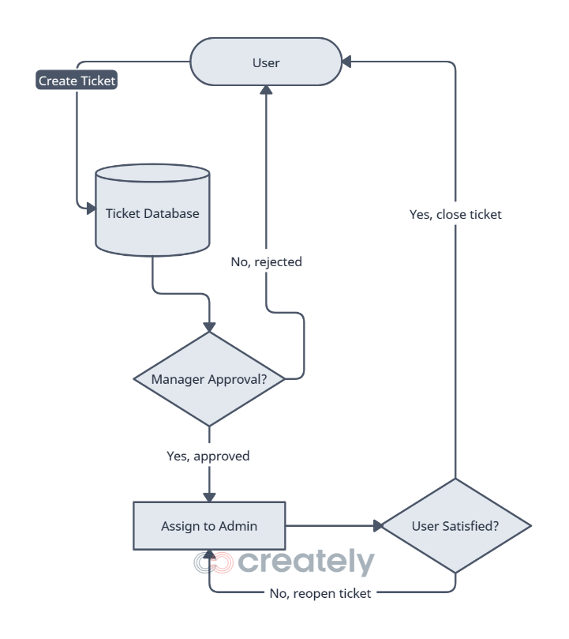
Ticket Lifecycle Flow Diagram

Slide 6
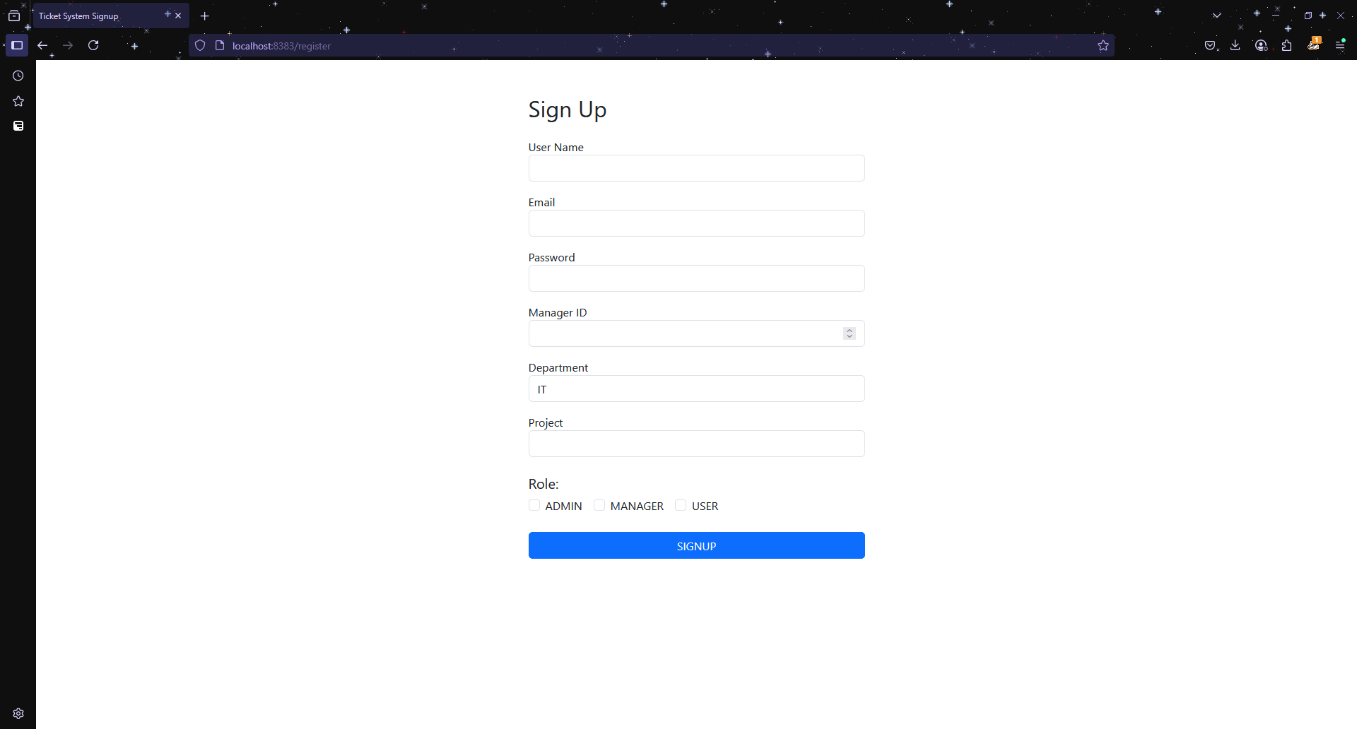
User Signup

Slide 7
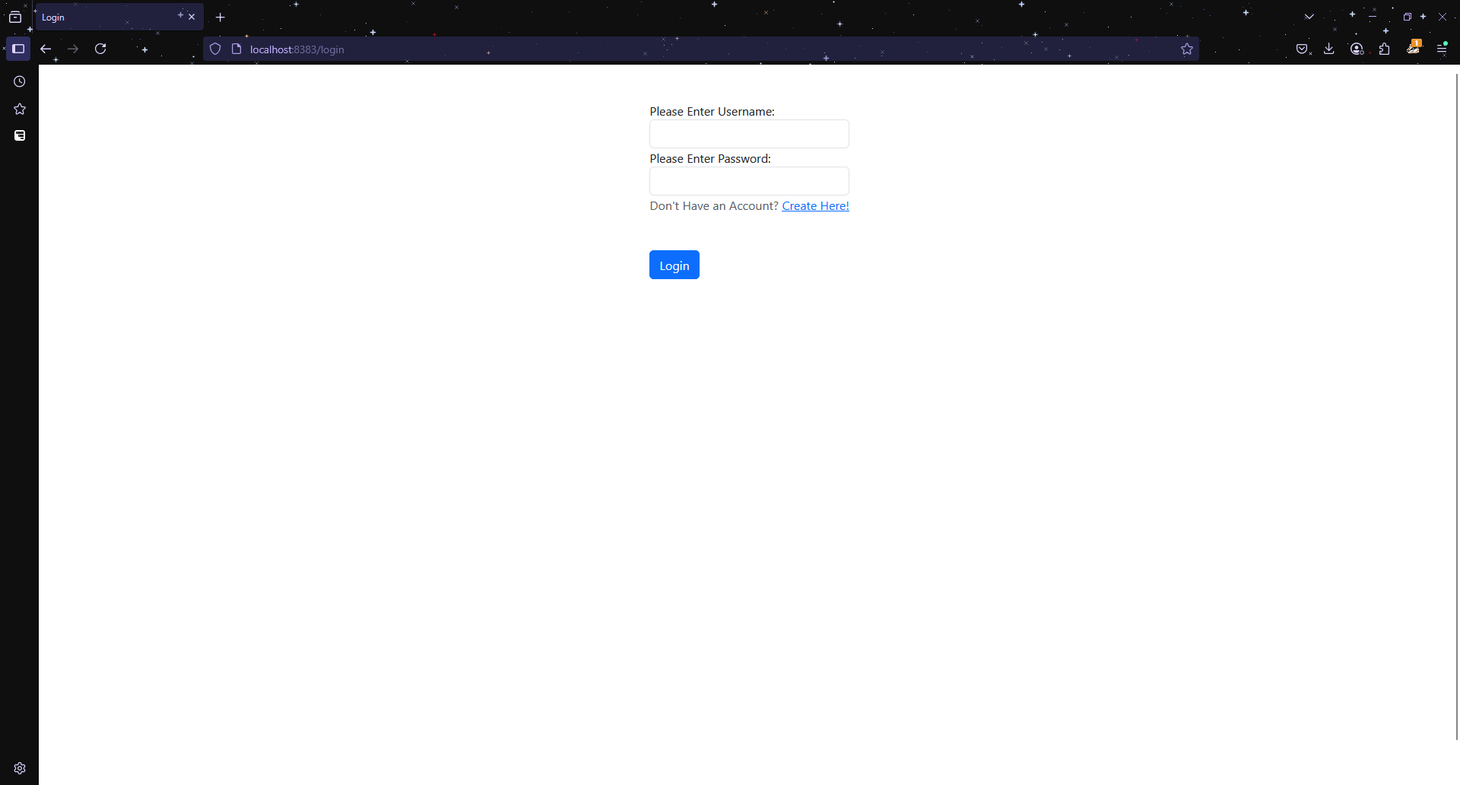
User Login

Slide 8
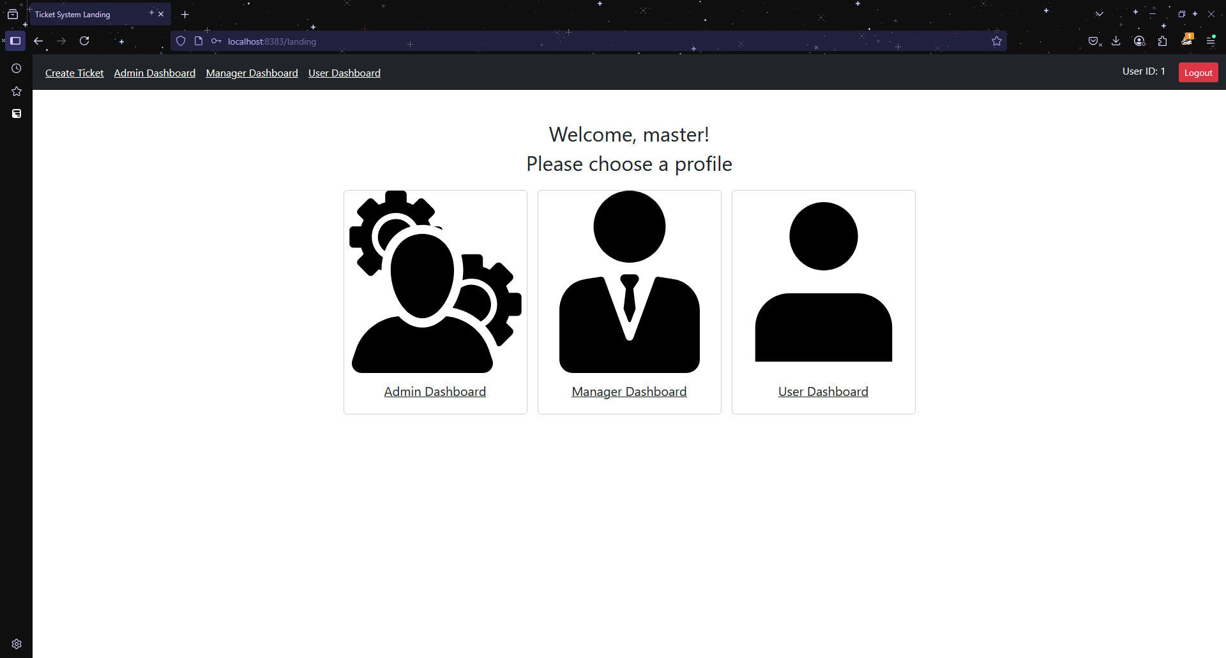
Landing

Slide 9
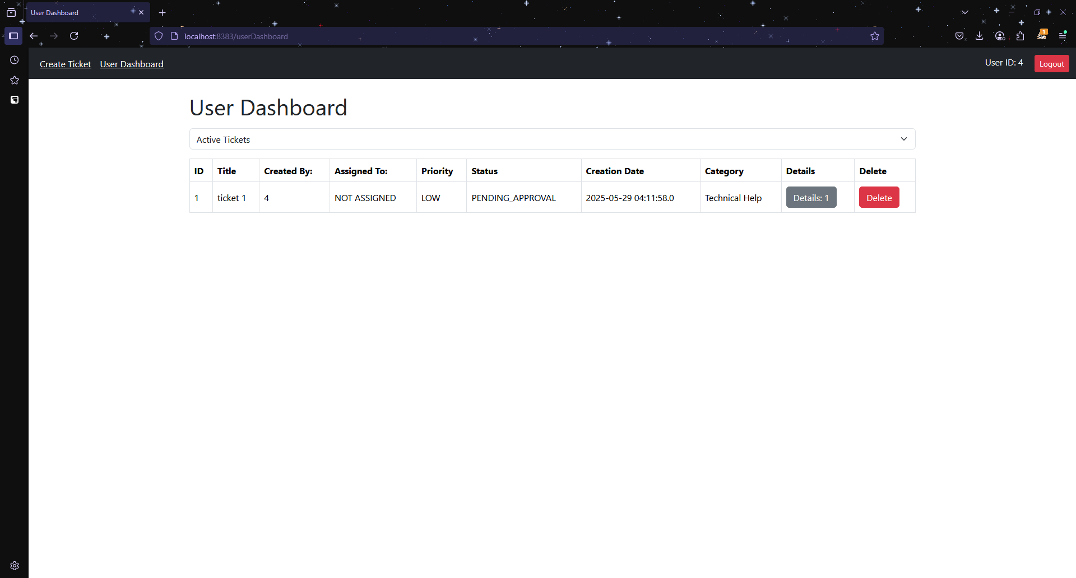
User Dashboard (active tickets)

Slide 10
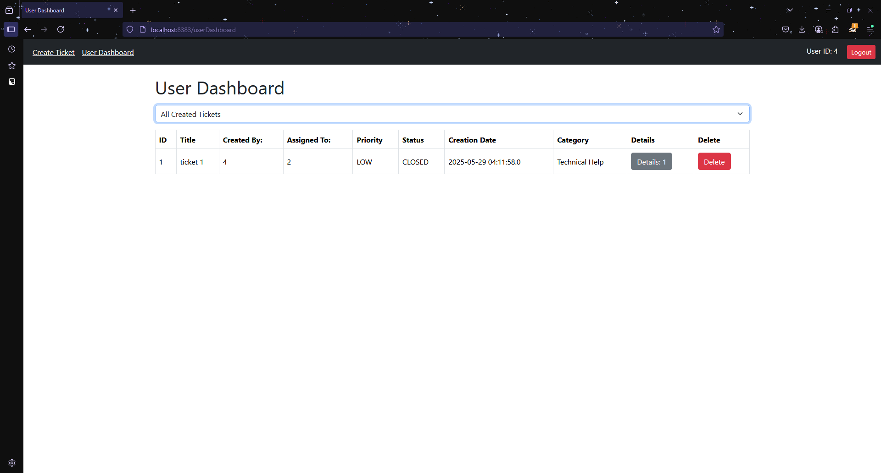
User Dashboard (closed/rejected tickets)

Slide 11
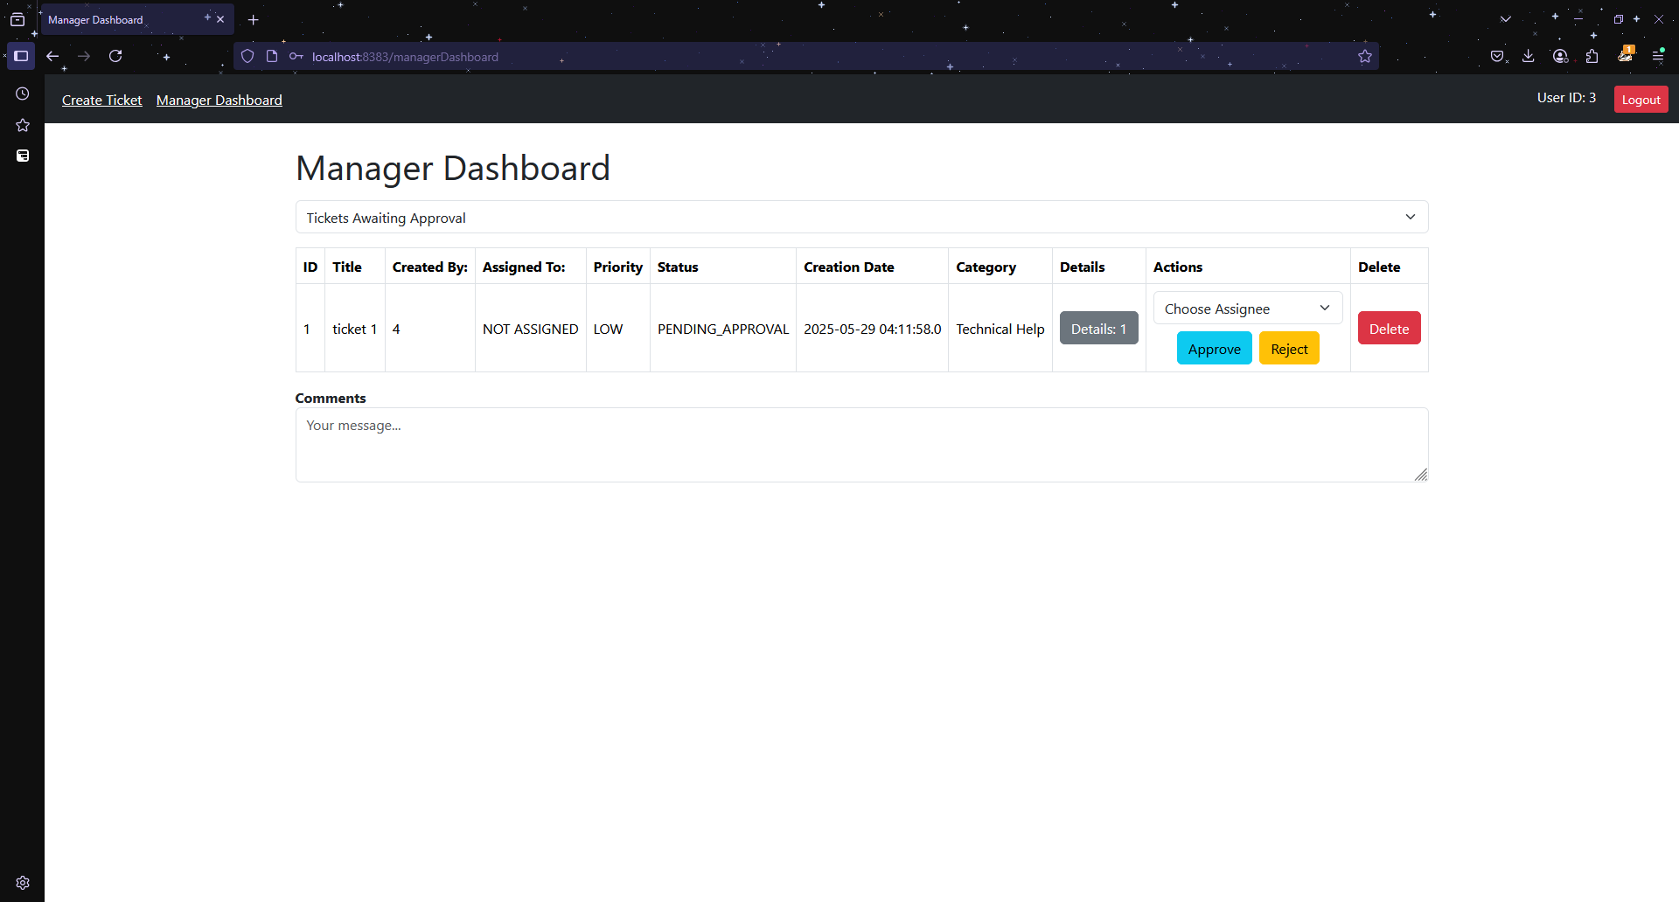
Manager Dashboard (pending tickets)

Slide 12
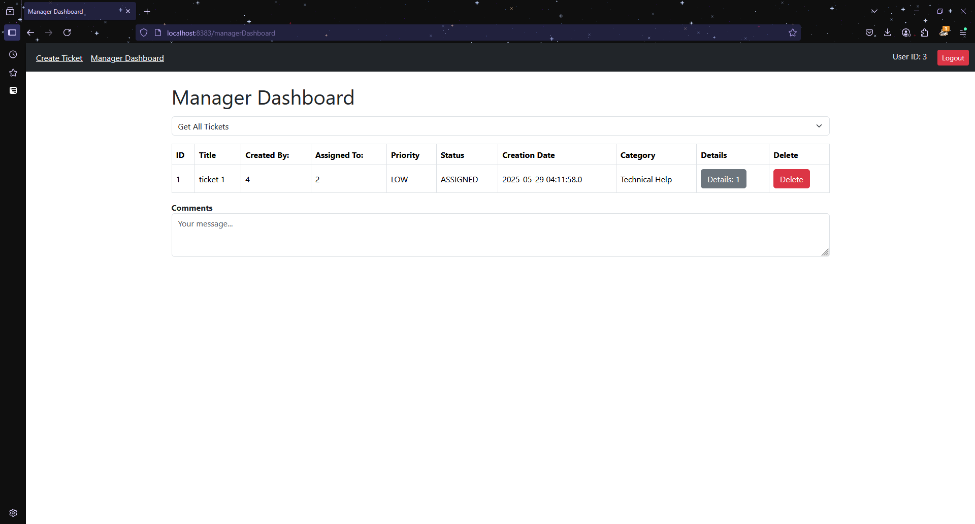
Manager Dashboard (all tickets)

Slide 13
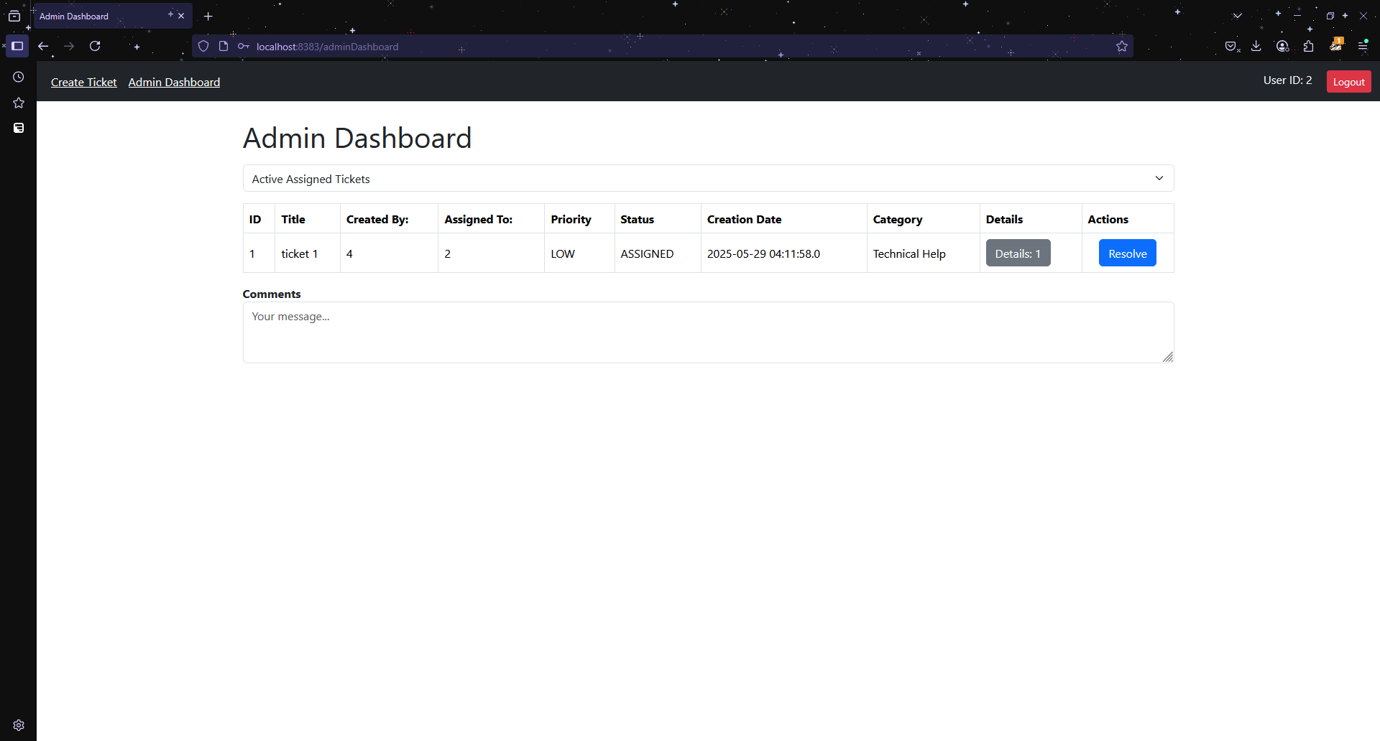
Admin Dashboard (assigned tickets)

Slide 14
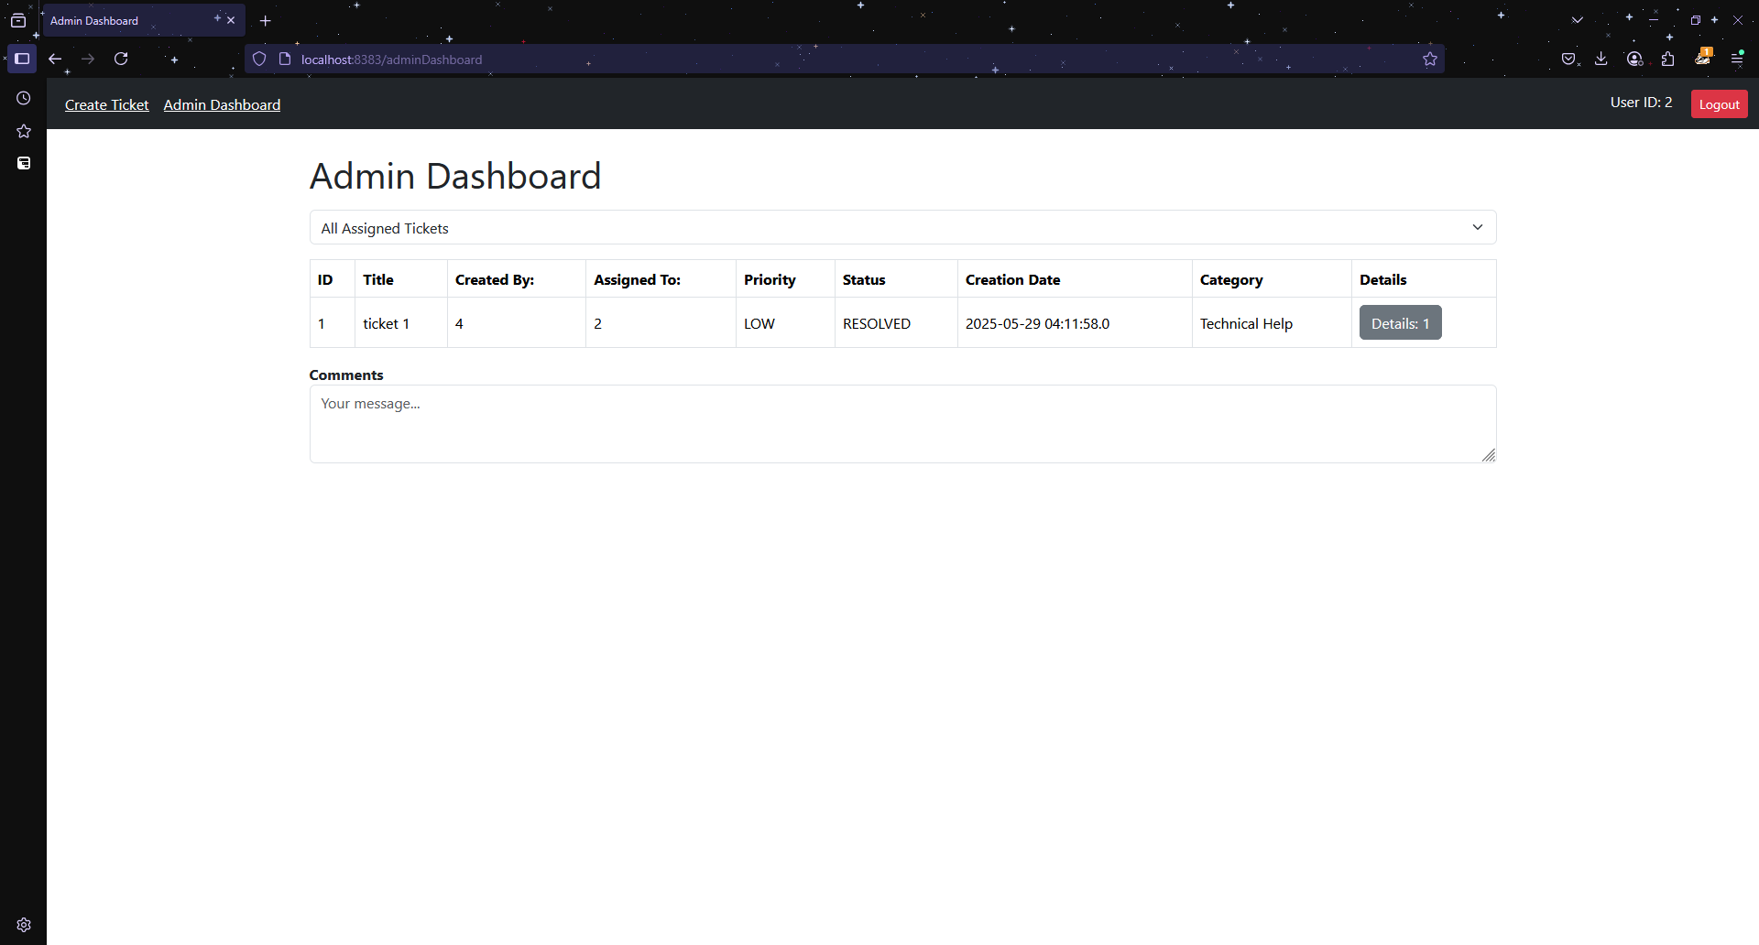
Admin Dashboard (all previously assigned tickets)

Slide 15
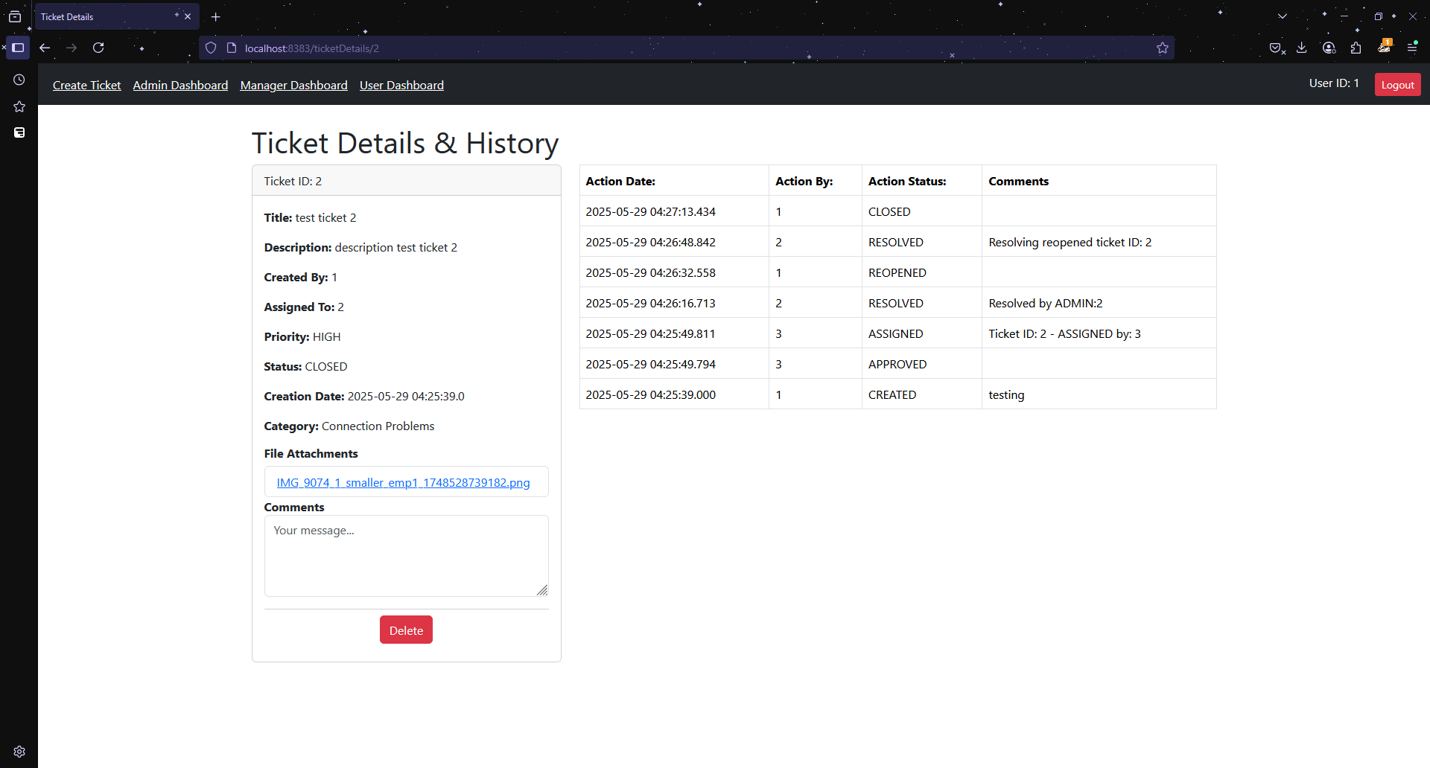
Ticket Details (User)

Slide 16
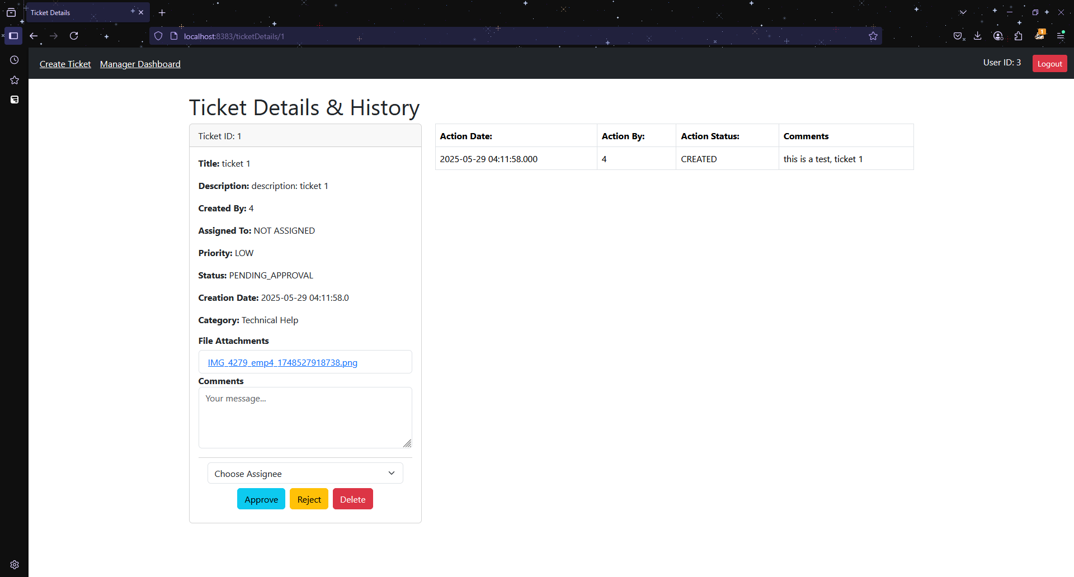
Ticket Details (Manager)

Slide 17
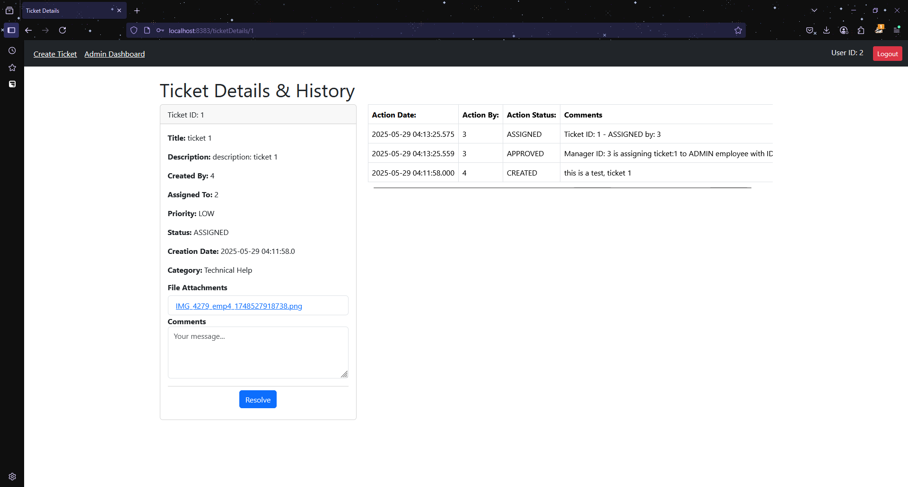
Ticket Details (Admin)

Slide 18
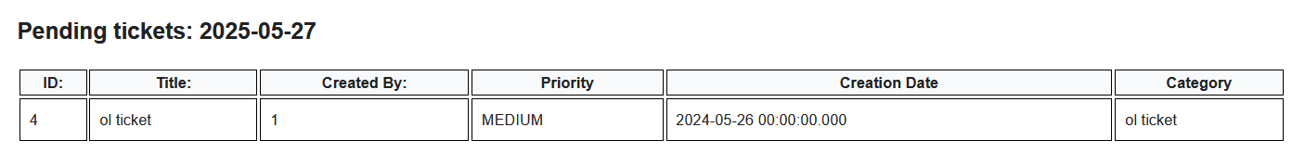
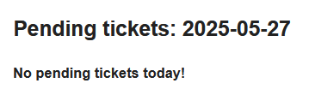
Email Notification - Manager (pending tickets)

Slide 19
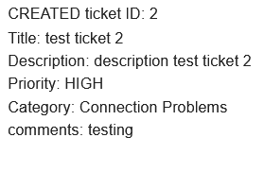
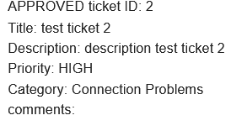
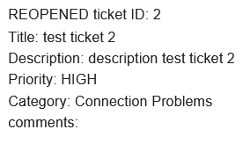
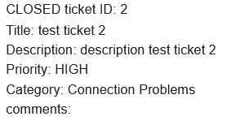
Email Notification - User (ticket updated)

Slide 20
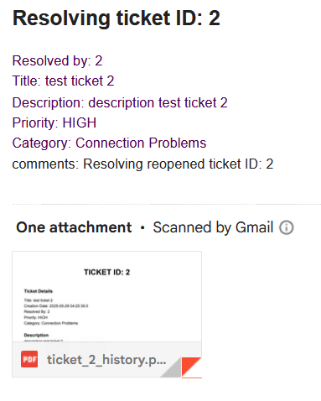
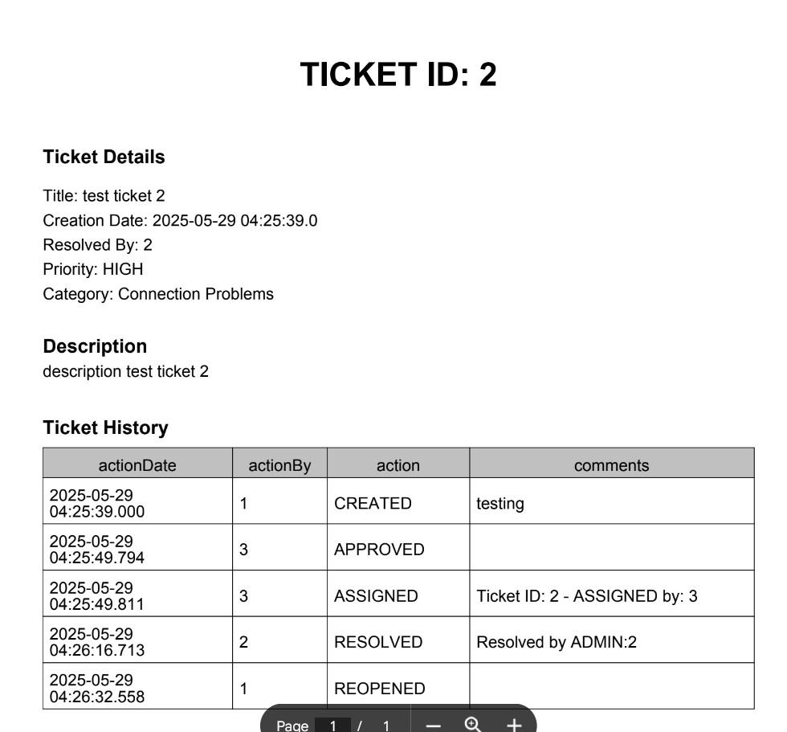
Email Notification - User (ticket resolved)

